Slide 1






Dual Education

Slide 2
K. Komilov, M. Madazimov, rectors of Higher Educational Institutions – report
Other Regions
Higher Education:
So far, meetings have been held with graduates of 7 higher education institutions in the current academic year.
a) In the 2024/2025 academic year, a total of 7,579 students from these 7 higher education institutions will graduate. Of these, 5,367 are from Andijan.
2,212
29.2 %
Residents of Andijan
5,367
70.8 %

Slide 3
Dual Education
Based on the assigned task, to organize the educational process of the graduating students of these 7 higher education institutions in the form of dual education, they have been assigned to large industrial enterprises, organizations, and educational institutions in the region, and currently, 7,018 graduates (92.6%) have been involved. (On any given day, 60-65% of students are studying in the dual education format).
Currently, 3,845 graduates (50.7%) are working in production and private enterprises and educational institutions in the region, as well as on a contractual basis, and 1,050 students are working as interns under a contract.

Slide 4
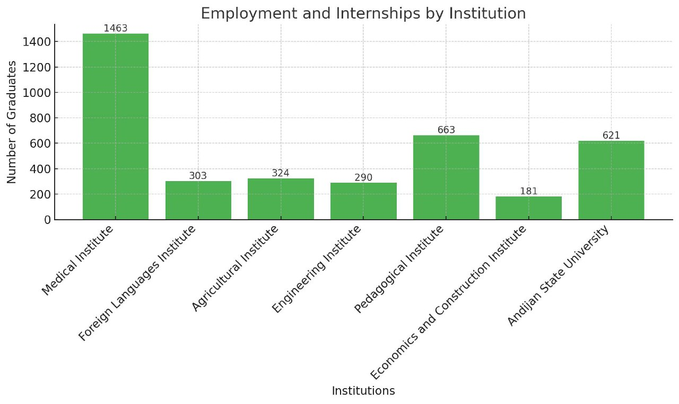
At the same time, the students’ participation in dual education and the 4+2 internship program is being closely monitored.
In addition, measures are being taken to employ 3,732 graduates and involve 559 students in dual education at production enterprises and organizations.

Slide 5
Dual Education
Vocational Education:
The region currently has 65 vocational education institutions with a total enrollment of 38,878 students.
a) Of these, 29,269 students (75.3%) have been assigned to 471 enterprises, organizations, and institutions in the region and are studying under the dual education system.

Slide 6
Regional Distribution
Furthermore, 495 classrooms have been established in enterprises, where 781 instructors teach students practical skills.

Slide 7
Regional Distribution
b) Out of 29,269 students involved in dual education, 24,500 (83.7%) are working as employees and interns in production on a contractual basis outside of class hours.
In the following regions, the participation rates are as follows:

Slide 8
Assignments
1. The Deputy Governor of the Region, K. Komilov, the Department of Higher Education, Science and Innovations (M. Madazimov), Rectors of Higher Education Institutions (Akbaraliyev, Madazimov, Turdialiyev, Sultanov, Rustamov, Tuychiboev, Rasulov), together with all district and city governors, are responsible for:
• Assigning the remaining 559 graduates from higher education institutions and 9,609 graduates and students from vocational education institutions to regional production enterprises, organizations, and institutions, engaging them in dual education programs;
• Ensuring that 3,732 graduates from higher education institutions are employed and 559 students are involved in dual education programs within production enterprises and organizations;
• Regularly monitoring and evaluating the conditions, education, and practical training processes provided to students at production enterprises, organizations, and institutions through a working group;
• Providing critical reports to each district (city) and higher education institutions during the “Governorship Hour” organized by the working group;

Slide 9
Assignments
2. All district and city governors are responsible for:
Meeting with graduates of vocational education institutions within their jurisdiction and personally overseeing the implementation of the dual education system at a high level, including organizing students into local enterprises and organizations;
Ensuring the creation of conditions for students involved in dual education, including providing workplaces within assigned enterprises and organizations, organizing classrooms, and arranging for their employment.
• • • • • • • • • • • • • • • • • • • • • • • • •
3. The Deputy Governor of the Region, K. Komilov, the Department of Higher Education, Science and Innovations (M. Madazimov), and Rectors of Higher Education Institutions (Akbaraliyev, Madazimov, Turdiayev, Sultanov, Rustamov, Toychiboev, Rasulov) are required to provide daily updates to the Governor of the Region on the progress of the assigned tasks.

Slide 10
Information on the establishment of Dual Education for graduates of Andijan State Pedagogical Institute at production enterprises and organizations.
1,077
1,502
425
2,212
Students working under a directive or those who are interns
5,367
663
771
68

Slide 11


Thank you
for your attention!

